Slide 1
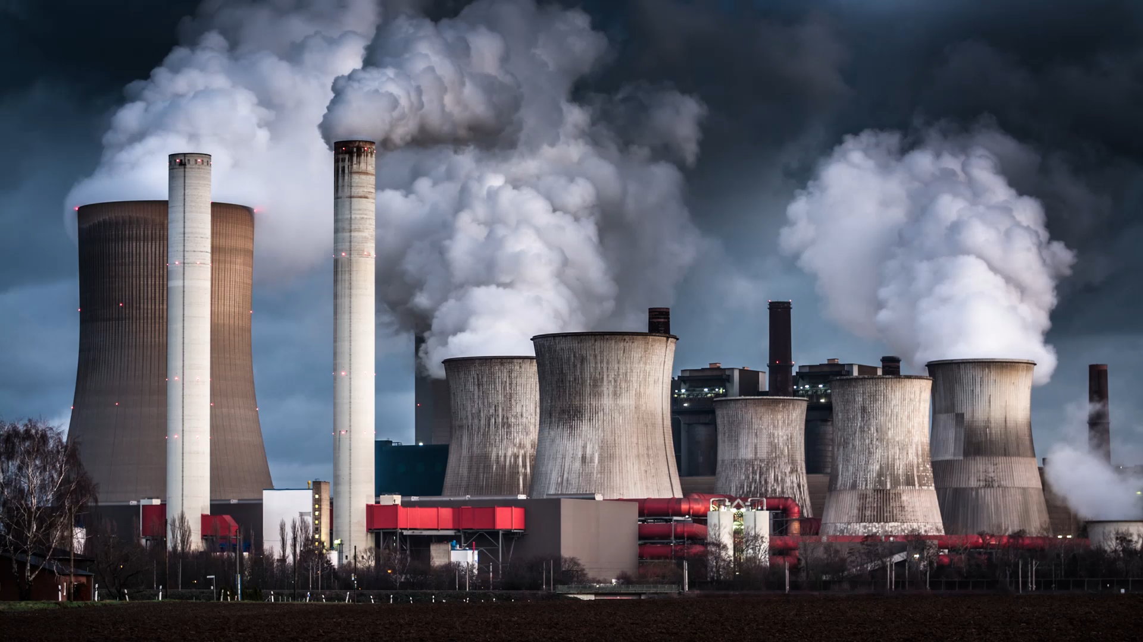
Green House Gas Emission Analysis
Harithaa Kannan

Slide 2

Problem Statement
In Ontario, the Broader Public Sector (BPS) plays a significant role in energy consumption and greenhouse gas (GHG) emissions. Despite efforts to address sustainability, there remains a lack of comprehensive analysis and actionable insights. Therefore, the problem at hand is to leverage available data to thoroughly analyze energy consumption patterns and GHG emissions across BPS organizations in Ontario.
The aim is to:
identify trends
evaluate the effectiveness of current conservation initiatives
highlight areas for improvement

Slide 3
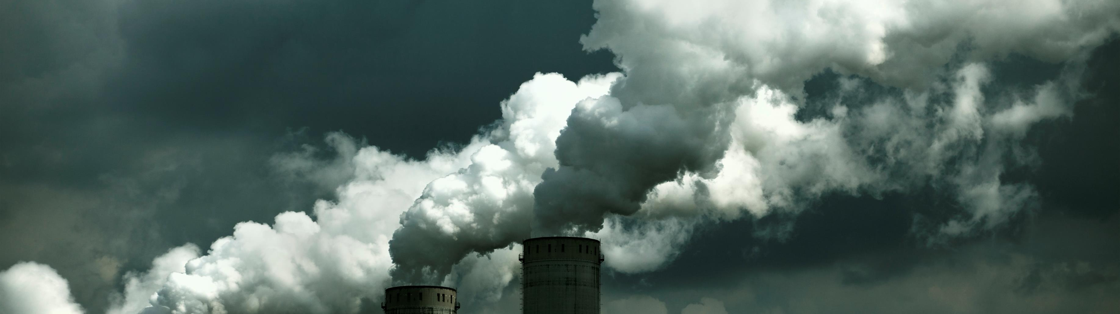
Tools Used
To achieve the goals mentioned the tools used are:
Excel : To understand , Manipulate and form a cleaner database from the data given for future analysis
PowerBI: To explore and understand the cleaned data more visually , to find insights and to present the said insights
PowerPoint: To present the process and findings

Slide 4
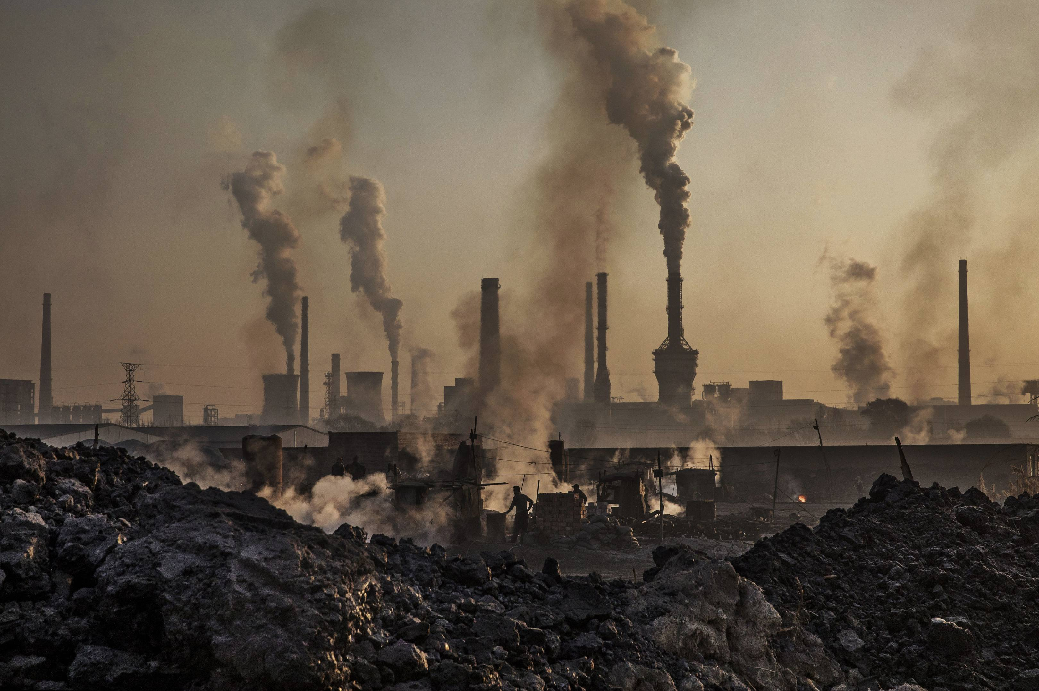
1.
Data Cleaning
2. Understanding data
3.
Finding Insights and Visualization
Data in separate files
Not clean
Column headers difference
0 in important fields
Blank fields
Wrong data in wrong fields
Wrong units
Technical column names
Understanding Units
Role of each columns
Relationship across data
How to present the findings

Slide 5

Some EDA insights
Toronto London Ottawa has been the top 3 GHG emission Cities
Each year the School boards from Toronto has the highest emission
Out of all the places York University is the largest and produces the highest amount of GHG
Propane is most used among wood , kerosene , coal , fuel
Top cities in 2012 and 2013 were North Bay , Timmins , Kapuskasing, Temiskaming Shores and Sturgeon Falls
From 2012 to 2016 Indoor ice rinks seem to have a significant use of Electricity but it starts to steadily dip from 2017 onwards
Among school boards K-12 School seem to have the highest emission of GHG , Natural Gas and also the highest use of electricity

Slide 6
Conclusion
Suggestions
From the information I have gather we can identify serious problems with certain cities and facilities in terms of GHG emission.
This indicates the need for targeted sustainability initiatives in these areas to reduce emissions.
We also learnt that major issue lies with the school board, and this suggest that Implementing energy conservation measures and renewable energy solutions can help mitigate emissions in educational facilities.
Develop targeted emission reduction programs in high-emission cities like Toronto, London, and Ottawa
Implement sustainability initiatives in educational institutions
Encourage the adoption of cleaner energy sources
Explore opportunities for efficiency improvements to reduce electricity usage
Implement energy conservation measures in K-12 schools to reduce GHG emissions
Foster collaboration among BPS organizations, government agencies, and community stakeholders to develop and implement sustainable practices

Slide 7

Thank you
Open for questions

